Slide 1
Professional Ethics for Site Auditors
Understanding the Dos and Don’ts

Slide 2
Content Overview
Code of Ethics for SPI-RRT Auditors
Code of Conduct for SPI-RRT Auditors
Apply the Rules of Conduct for SPI-RRT Auditors
Understand appropriate actions to maintain site integrity and client confidentiality
Ethical considerations
Training Approach

Slide 3
What is Ethics
“A set of principles of right conduct”

Slide 4
Code of Ethics for SPI-RRT Auditors
Maintain strict confidentiality of client information, test results, and site quality assurance data
Safeguard the dignity and privacy of clients
Be accountable for the quality and integrity of the SPI-RT audit process
Auditors shall act fairly, without prejudice or conflict of interest, towards all clients

Slide 5
Code of Conduct for SPI-RRT Auditors
SPI-RRT auditors are required to adopt conduct based on respect for the clients and site:
Adopting rules of courtesy and politeness
Sensitivity and care for client's needs
Maintaining a respectful appearance
Arriving punctually for meetings and audit visits
Not abusing in any manner, whether direct or implied, the inherent “power” an auditor has.
SPI-RRT auditors are required to follow rules of conduct for:
Integrity, Objectivity, Confidentially, Competency

Slide 6
RULES OF CONDUCT
Integrity
Objectivity
Auditors exhibit the highest level of professional objectivity in gathering, evaluating, and communicating information about the process being examined.
Auditors establish trust and thus provide the basis for reliance on their judgement
Confidentiality
Auditors respect the value and ownership of information they receive and do not disclose information without appropriate authority unless there is a legal or professional obligation to do so.
Competency
Auditors apply the knowledge, skills, and experience needed to conduct an audit

Slide 7
Responsibilities
Auditors shall:
Perform their work with honesty, diligence, and responsibility.
Not knowingly be a party to any illegal activity or engage in acts that are discreditable to the profession of auditing or to the ministry of health.
Respect and contribute to the legitimate and ethical objectives of the ministry of health

Slide 8
Integrity
Auditors during the process of gathering information for the SPI-RRT audit must maintain the integrity of the site :
Obtain permission to preform audit from administrative staff
Obtain permission to enter each room
Obtain permission to review any document, logbook, register, or QA records
Obtain permission for each photograph taken
  Do not photograph clients or clients information

Slide 9
Objectivity
Auditors shall:
Not participate in any activity or relationship that may impair or be presumed to impair their unbiased assessment.
Not accept anything that may impair or be presumed to impair their professional judgment.
Disclose all material facts known to them that, if not disclosed, may distort the reporting of activities under review.

Slide 10
Confidentiality
Auditors shall:
Be prudent in the use and protection of information acquired in the course of their duties.
Not use information for any personal gain or in any manner that would be contrary to the law or detrimental to the legitimate and ethical objectives of the ministry of health

Slide 11
Competency
Auditors shall:
Engage only in those services for which they have the necessary knowledge, skills, and experience.
Continually improve their proficiency and the effectiveness and quality of their services

Slide 12
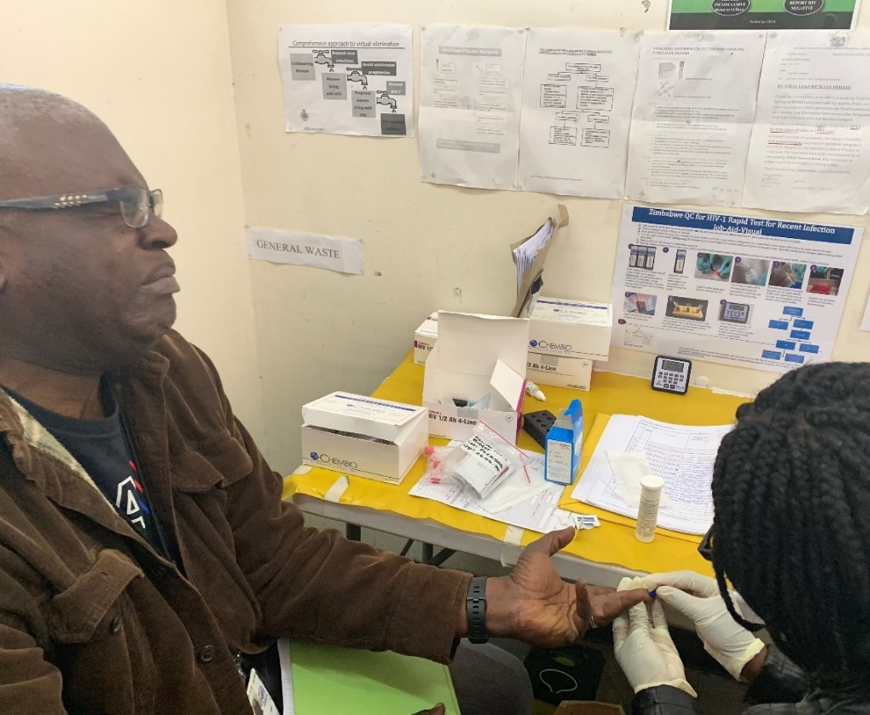
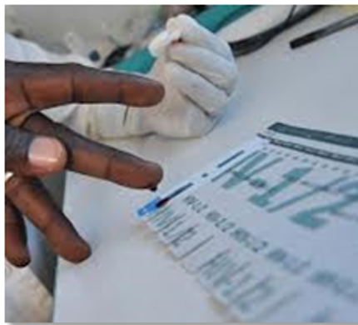
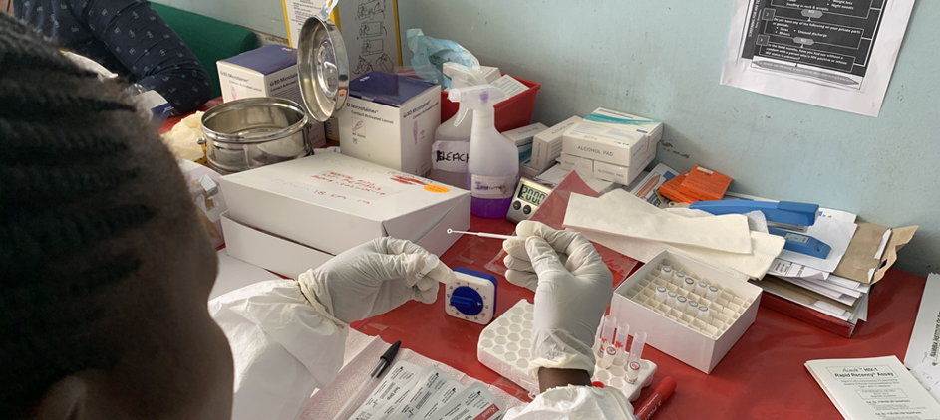
Ethical Scenarios

Slide 13
Scenario I
Sylvia, an auditor, has just completed audits for 5 HIV rapid testing sites in her district. Sylvia was scheduled to visit another site for an audit; however, she decides to stop for lunch on the way and afterwards left copies of the audit summary reports in the restaurant. Instead of going back to get the copies, she decides it doesn’t matter since the pages do not contain client data.

Slide 14
Scenario II
John, an auditor, has just reviewed the HTS Test Register during a site visit. John notices that one of the testers accidentally wrote the name of the client in the HTS Test Register instead of their client code. John recognizes who the client is and realizes that he is HIV positive. John decides to tell his friend’s wife of his HIV status.

Slide 15
Scenario III
You are auditing a PMTCT site, and you are observing a nurse counselor performing the HIV rapid test. You notice that the nurse counselor just ran out of the buffer for Test 1 of the algorithm. Rather than denying testing to clients, the nurse counselor decides to go ahead and perform Test 1 using the buffer from kits of Test 2.

Slide 16
Scenario IV
A couple has come to a VCT clinic for HIV rapid testing. The lay counselor there does the pre-test counseling for the couple and performs the Determine HIV ½ test but leaves the testing area for almost an hour. Philip, an auditor, is at the VCT clinic for a routine site visit. He sees the couple sitting outside the office waiting for the lay counselor. He is unsure why it is taking so long for them to receive their results so he decides to check the results himself. He sees a series of Determine test strips and reviews the results of the first one he sees thinking they probably belong to the couple outside. One of the tests is positive and he proceeds to give them their results.

Slide 17
Key Messages
Ethical issues are important. We must constantly remind ourselves of the code of conducts and ensure we do the right thing.
Ethical issues are often hard to deal with because they create dilemmas.
People often violate ethics not because they mean to, but because they are careless. As a matter of fact, they sometimes act with good intentions.

Slide 18
Review
In your own words, what is professional ethics for a SPI-RT auditor?
Why is it important?
Give examples of actions you can take to maintain client confidentiality.
Give an example of a code of ethics to which you are willing to personally commit.

Slide 19

Thank You

